Slide 1
ISNS CASE STUDy
With Dr. Norbert Ketskes on Non-Insulin Dependent Diabetes Mellitus

Slide 2
Medical Disclaimer
The information provided is for educational purposes and is not intended as medical advice, or a substitute for the medical advice of a physician or other qualified health care professional. This is for science and educational purposes only and cannot be used in any aspect for sales or marketing. You should not use this information for diagnosing a health or fitness problem or disease. You should always consult with a doctor or other health care professional for medical advice or information about diagnosis and treatment. This is Confidential. Do not distribute—for scientific educational purposes only.

Slide 4
DR. NORBERT KETSKÉS, MD
Dr. Norbert Ketskés M.D. is one the most acknowledged gastroenterologist in Hungary, specializing in natural and organic nutritional solutions, leading the well-known Primus Labor, a private clinic offering personalized nutritional advices to its patients.
Scientific Adviser of ISNS
Independent Scientific Adviser of Rain International in Europe since 2013
Medical Partner of the Hungarian Olympic Committee since 2015
Member of the Medical board of Hungarian Karate Association since 2015
Leader of the Primus Labor Private Medical Clinic since 2013
Working as a Family Doctor 1999 – 2012

Slide 5
CSISZTU ZSUZSA
Television - Presenter, Anchor, Editor, Journalist and Sports Lawyer, Sport-diplomat
Spokesperson of the Giro d’Italia Grande Partenza, (Road-Cycling World -Tour Championship)
Spokesperson of the FINA (Swimming and Waters poets World Championship)
2022 Vice-President of the Hungarian Sports Journalists’ Association
Member of the Hungarian Olympic Committee Member of the Advisory Board of the Hungarian Olympic Academy
Newly Elected Vice-President of the International Sports Journalists Association, the first female ever in the field from her homeland, and third globally since 1924 (AIPS)

Slide 6
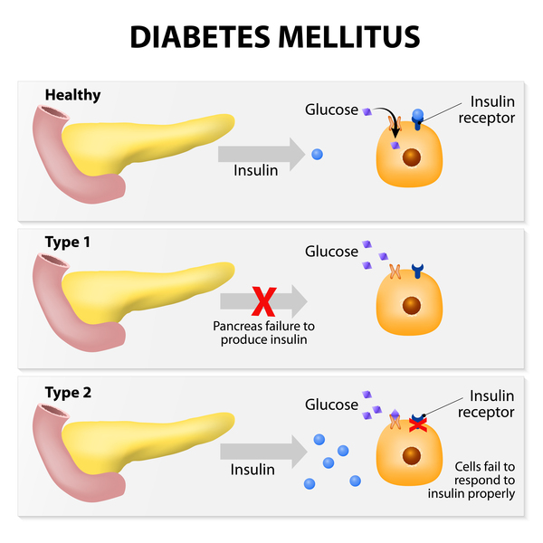
Non-insulin dependent Diabetes Mellitus
Non-insulin-dependent (type II) diabetes mellitus is an inherited metabolic disorder characterized by hyperglycemia with resistance to ketosis. The onset is usually after age 40. Patients are variably symptomatic and frequently obese, hyperlipidemic, and hypertensive. Clinical, pathological and biochemical evidence suggests that the disease is caused by a combined defect of insulin secretions and insulin resistance.
Non-Insulin-Dependent (type II) Diabetes has been divided by the World Health Organization (WHO) into two main groups
Obese
Non-Obese

Slide 7
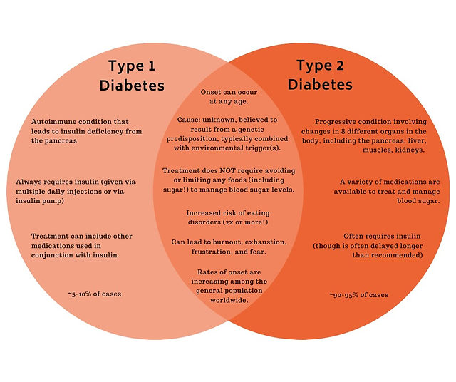
Types of Diabetes
Insulin metabolism is abnormal in diabetes, either because of:
Reduced secretion
Sensitivity to its effects
There are two main types of Diabetes:
Insulin-dependent (IDDM or type 1 diabetes mellitus, formerly juvenile onset)
Non-insulin-dependent (NIDDM or type 2 diabetes mellitus, formerly maturity onset)

Slide 8
Non-Insulin Dependent Diabetes Mellitus (Type 2)
Insulin secretion is retained, although it is inadequate to control blood glucose levels.
There is resistance to the effects of insulin due to reduced insulin receptors
Genetic factors are an important etiological factor in NIDDM
There are no HLA associations and no islet cell antibodies found.
Not all patients with NIDDM are overweight, but there is a clear association with obesity

Slide 9
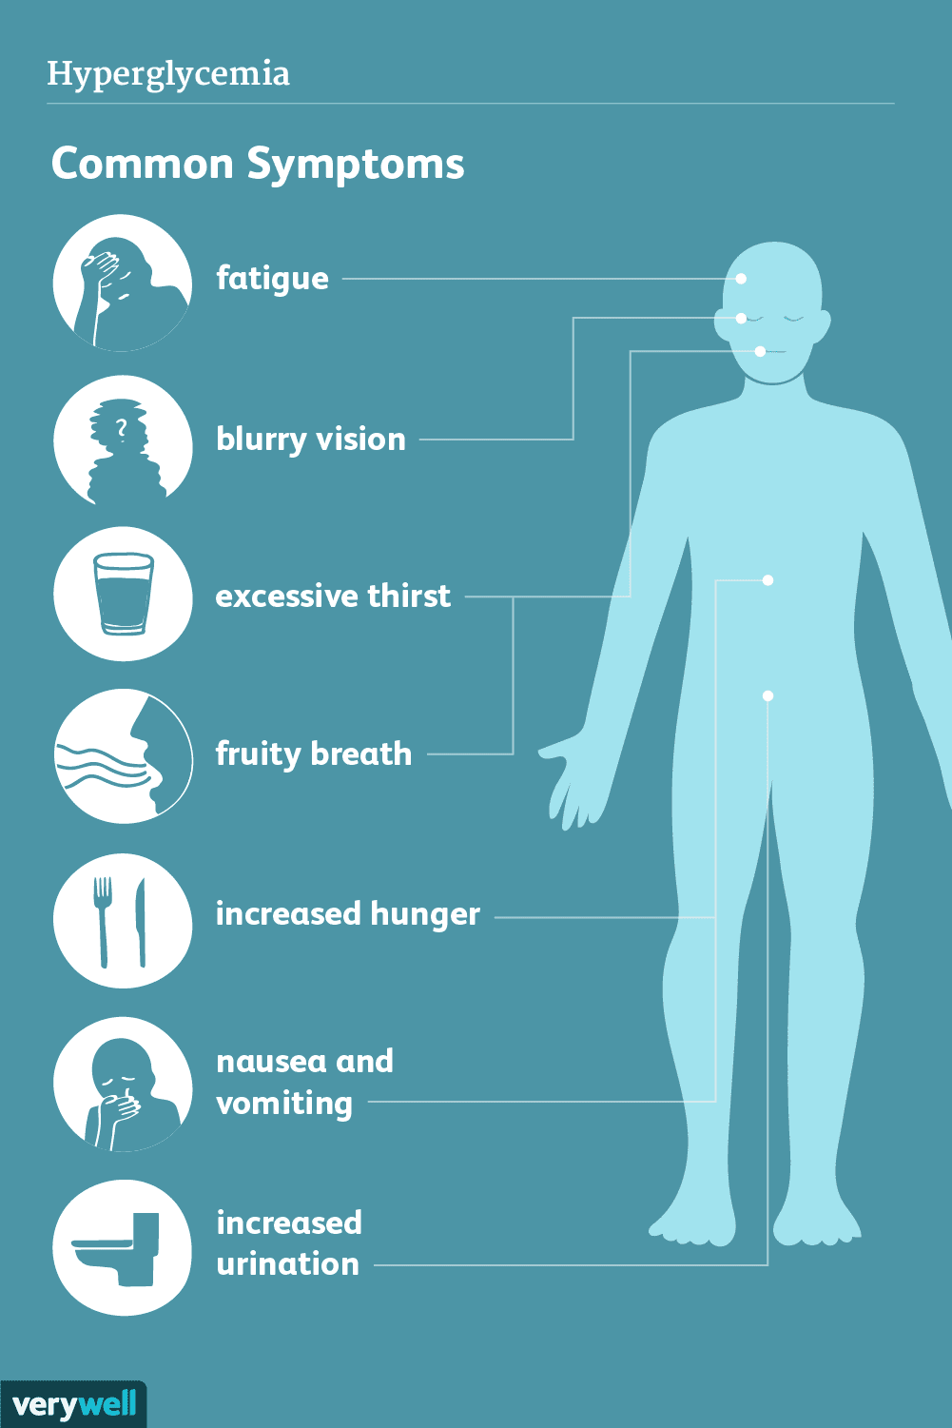
NIDDM Signs & Symptoms
The increased blood glucose levels seen in diabetes can eventually damage a person’s blood vessels, nerves, and organs. The body attempts to remove the excess glucose through urination and the most common symptoms of type 2 diabetes include the following:
Polydipsia (increased thirst)
Polyphagia (increased hunger)
Polyuria (increased frequency of urination), especially during the night
Extreme fatigue, weight loss, and sudden loss of muscle bulk
Some of these symptoms are also seen in type 1 diabetes but type 2 diabetes symptoms tend to develop more gradually and can take months or years to manifest. This can make it more difficult for people to tell if they have underlying health condition and often people have had type 2 diabetes for a long time before it is finally diagnosed.

Slide 10
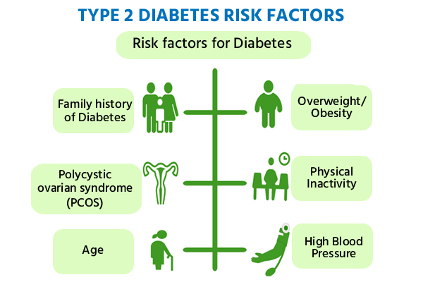
NIDDM Risk Factors
Several factors can increase a person’s risk of developing diabetes. Examples include:
Being overweight or obese
An unhealthy diet
Low levels of physical activity
Waist measurement of 31.5 inches or more for women
Waist measurement of more than 37 inches among men
Raised cholesterol
High blood pressure
Smoking
A family history of diabetes can also increase a person’s risk of developing the condition. Studies have shown that the offspring of families where one parent has diabetes, are at a 15% risk of developing the condition and that offspring born to two parents with diabetes has a 75% increased risk.

Slide 11
CASE STUDY
Patient: Female
Age: 60 years old
Family history:
Both grandmothers were also diabetic (NIIDM)
Medical history:
Hypertension for 10 years, overweight, smokes (10 pcs/day),
6 months ago 17.2 mmol/l!! during a routine laboratory test fasting blood sugar level detected (normal value: 4.0-6.4 mmol/l), Carbamid: 11.8 mmol/l (norm.: 2.0-7.2), creatinin: 114 mmol/l (norm.: 59-104),
Diabetologist opinion:Type 2 diabetesRecommended therapy:Metformin 500mg once a day for 1 week, then twice a day
Diet and exercise of course
Control ( in1 month):
Blood sugar level:14 mmol/l
Carbamid: 10.8 mmol/l (norm.: 2.0-7.2), creatinin: 110 mmol/l (norm.: 59-104),
Recommended therapy:Metformin 500mg twice a day and Gliclazid 2x60mg

Slide 12
CASE STUDY
Medical history:
Control ( in1 month):
Blood sugar level:12 mmol/l
Carbamid: 11.8 mmol/l (norm.: 2.0-7.2), creatinin: 111 mmol/l (norm.: 59-104),
Recommended therapy:Metformin 1000mg in the morning and 500 mg in the evening and Gliclazid 2x60mg and Xultophy (inj.) 10mg/day (sc)
Control ( in1 month):
Blood sugar level:9,2 mmol/l
Carbamid: 10.8 mmol/l (norm.: 2.0-7.2), creatinin: 108 mmol/l (norm.: 59-104),
HBL (Hemoglobin) A1C%: 8.5 (norm: 4.0-6.4% , the therapeutic target range: below 7%) (the HGB A1C value is usually checked every 3 months)
Recommended therapy:Metformin 1000mg in the morning and 500 mg in the evening and Gliclazid 2x60mg and Xultophy (inj.) 10mg/day (sc)
Complaints:
Highly fluctuating blood sugar levels, fatigue, her weight did not change

Slide 13
Conventional Treatment
In general blood sugar should be regularly monitored so that any problems can be detected and treated early.
Treatment involves:
Lifestyle changes such as eating a healthy and balanced diet and regular physical exercise.
If lifestyle changes are not enough to regulate blood glucose levels, anti-diabetic medication in the form of tablets or injections may be prescribed.
Maintaining a healthy blood glucose level, blood pressure and cholesterol is essential to preventing the complications of type 2 diabetes. Overwight or obese indiviudals with diabetes often significantly reduce the extent of their symptoms by adjusting their lifestyle.

Slide 14
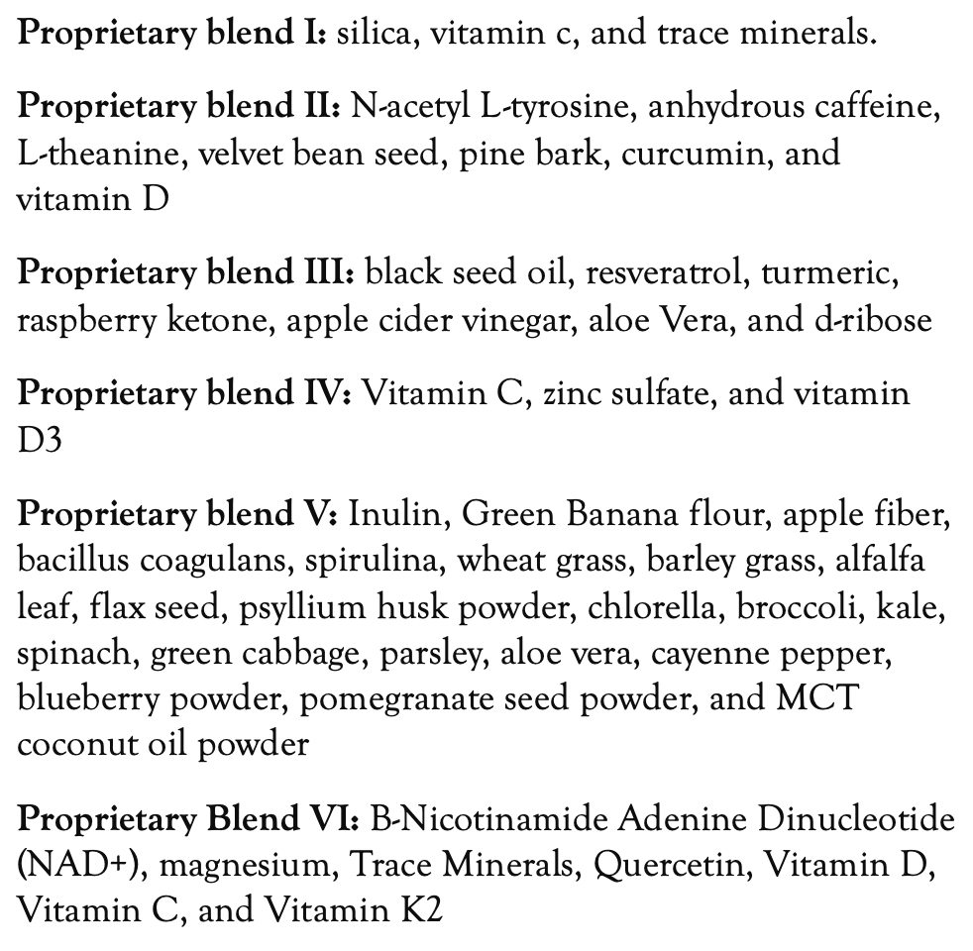
Method
PROPRIETARY BLENDS LEGEND
Proprietary blend I: 2x6 drops, morning and
evening, for 3 days, then every 3 days then
increased by 1-1 drops every 3 days to 2x10
Proprietary blend II.: 1 capsule in the morning for 7 days, then 1 capsule in the morning and 1 capsule in the afternoon
Proprietary blend III: 1/2 sachet in the morning
for 7 days then 1 sachet in the morning for 7 days then 1 sachet in the morning and 1 sachet in the evening
Proprietary blend IV: 1/2 teaspoon in the
morning
Proprietary blend V: 1 teaspoon in the
in the evening for 7 days, then 1 teaspoon in the morning and 1 teaspoon in the evening (1 month)
Proprietary blend VI: 1 in the
morning and 1 in the evening

Slide 15
Results
Control ( in1 month):
Blood sugar level:7,2 mmol/l (normal value: 4.0-6.4 mmol/l)
Carbamid: 8.8 mmol/l (norm.: 2.0-7.2), creatinin: 104 mmol/l (norm.: 59-104),
Control (in 3 month)
Blood sugar level:6,2 mmol/l (normal value: 4.0-6.4 mmol/l)
Carbamid: 5.6 mmol/l (norm.: 2.0-7.2), creatinin: 88 mmol/l (norm.: 59-104),
HBL (Hemoglobin) A1C%: 6.4!! (norm: 4.0-6.4% , the therapeutic target range: below 7%)
Blood sugar level stabilized!!,
The fatigue is gone and she has lost 8 kg!

Slide 16
References
https://www.ncbi.nlm.nih.gov/pmc/articles/PMC1336077/
https://www.ncbi.nlm.nih.gov/pmc/articles/PMC9804244/
https://www.ncbi.nlm.nih.gov/pmc/articles/PMC6906884/
https://www.ncbi.nlm.nih.gov/pmc/articles/PMC5641400/

Slide 17
Thank You for Joining Us This Week!!

